Slide 1



April- 2018
“ Emotional Intelligence is core Competency of an Agile Servant Leader”
Presented By-Md. Mizanur Rahman PMP,CSP

Slide 2
Emotion
A strong feeling deriving from one's circumstances, mood, or relationships with others.
Fulfilled
Contented
Glad
Complete
Satisfied
Optimistic
Pleased
Ecstatic
Energetic
Aroused
Bouncy
Nervous
Perky
Antsy
Intimate
Loving
Warm Hearted
Sympathetic Touched
Kind
soft
Tense
Nervous
Anxious
Jittery
Frightened
Panic-stricken
Terrified
Irritated
Resentful
Miffed
Upset
Mad
Furious
Raging
Down
Blue
Mopey
Griped
Dejected
Depressed
Heart Broken
Happy
Excited
Tender
Scared
Angry
Sad

Slide 3







Agile Leader/Scrum Master/APM
CIO
Finance
PMO
BA
Sales
Sponsor
ASL
Development Team
R&D
IT
Business

Slide 4
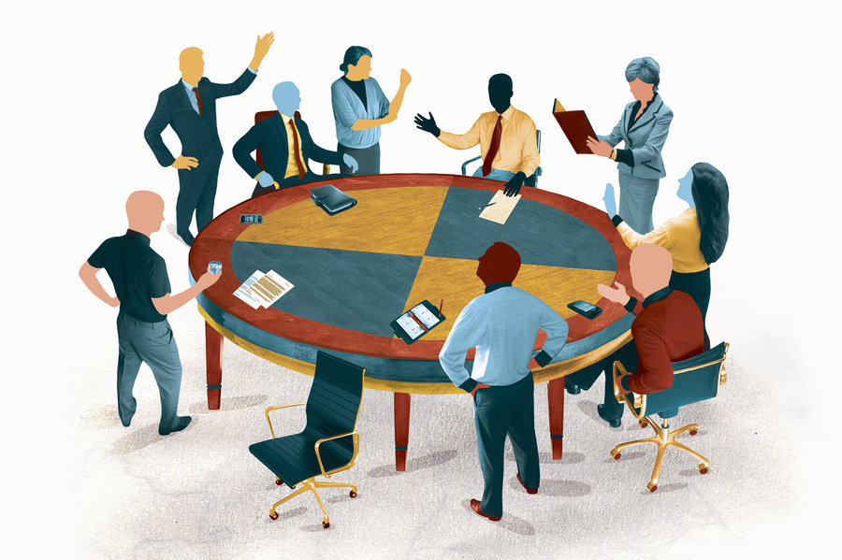
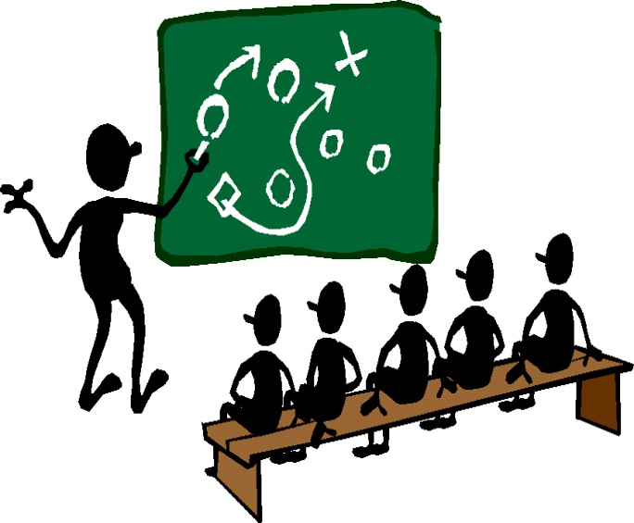
Meetings
Facilitating meetings for the team. This includes:
  Preparing
  Moderation
  Postprocessing
  Holding Retrospective which is a especial Meeting
Meetings
Team Dynamics
Coaching team members (e.g. with one-on-one coaching).
Conflicts mitigation.
Helping the team to make decisions.
Promoting the developer team to be self-organize.
Resolving the general conflict between development team (high technical quality) and product owner (more features).
Helping the team to get rid of impediments.
Suggesting new metrics for the team as catalysts for change.
Team Dynamics

Slide 5


Learning
Continuing learning regarding everything Agile (e.g. visit user groups, attend conferences, read books, write blogs, etc.).
Consulting team members regarding everything Agile.
Helping the team to create information radiators.
Giving feedback to the team.
Encouraging the use of Agile Engineering Practices within the development team
Doing Gemba Walks.
Learning
Product
Helping to write or split user stories.
Helping to write or adapt product visions.
Helping to order product backlog items.
Helping with the release planning.
Being familiar with the team’s work (i.e. the product).
Product

Slide 6



Mirror
Reflecting Agile and Scrum values to the team.
Reminding the team of their arrangements (e.g. policies).
Helping the team to continuously improve their process.
Reflecting issues to the team through observation from outside of the team.
Asking open questions.
Checking all the models the team uses (e.g. Sprint backlog, metrics, etc.) and show them differences between the model and the real world.
Mirror
Miscellaneous
Helping the team to keep focus (e.g. by acting as a buffer between external distractions and the team).
Helping the team to maintain and use their Scrum tools (Story board, Action board, charts, backlogs, etc.).
Helping team and product owner to define a appropriate
  definition of done
  definition of ready.
Miscellaneous

Slide 7
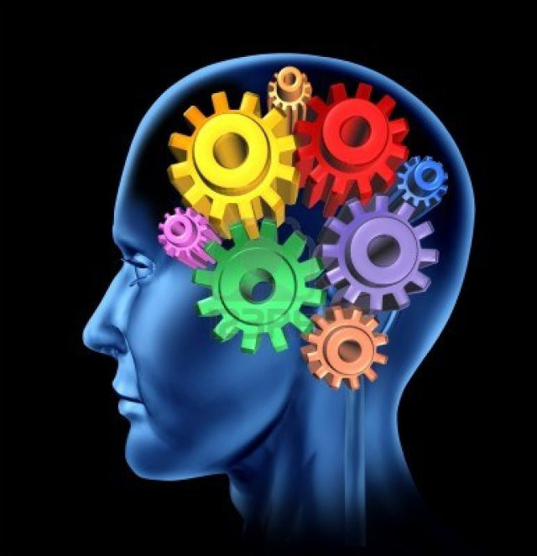

The leadership formula:
IQ + EQ +SQ - EGO
Intellectual Intelligence or IQ is the measure relative intelligence which is determined by several standardized tests.
IQ is the measure of cognitive ability, such as ability to learn, understand or to deal with new situation.
IQ means a mind without negative thoughts.
What I think? Left Brain Conative critical thinking.
Emotional Intelligence or EI is the capability or ability of individuals to identify and manage their own emotions and the emotion of others.
EI means a heart without negative emotions.
Manage and/or adjust emotions to adapt to environments or achieve one's goal(s).
What I feel? Right Brain Emotional Relationship.

Slide 8


The leadership formula:
IQ + EQ +SQ - EGO
Spiritual Intelligence inner wisdom guided by compassion.(inner and outer peace)
Spiritual Intelligence can improve self-esteem work on raising EQ.
SQ enables ones to more balance life
Helps to control anger, fear, sorrows, disappointment, irritations.
What I am? Soul meaning full inner self
A person's sense of self-esteem or self-importance. EGO means “I” or “self” which is obstacle.
The part of the mind that mediates between the conscious and the unconscious and is responsible for reality testing and a sense of personal identity.
EGO is small three letter word, which can destroy a big twelve letter word REALTIONSHIP .
EGO is just like dust in eyes. Without clearing dust we can’t see anything clearly, So clear the ego and see the world.
Empty vessels make the most noise. More Knowledge less EGO, Less knowledge more ego.

Slide 9
SELF
SOCIAL
SELF AWARENESS
SOCIAL AWARENESS
The ability to recognize and
understand your modes and
emotions and drive as well as
their effect on others.
The ability to understand the
emotional makeup of the other
people, skill of treating according
to their emotional reaction.
RECOGNITION
WHAT I SEE
Self-confidence
Emotional Self Awareness
Accurate Self Assessment
Empathy
Organizational Awareness
Understanding the environment
SELF MANAGEMENT
SOCIAL SKILLS
The ability to control or redirect
disrupted impulse and modes,
the propensity to suspend
judgment- to thing before acting
Proficiency in managing relationship and building networks and ability to find common ground and build rapport.
REGULATION
Self-Control
Adaptability
Drive & Motivation
Initiative
Influence
Building bonds
Team work and collaboration
Inspirational Leadership
WHAT I DO
How we manage ourselves?
How we handle relationship?

Slide 10
How to Improve or develop your Emotional Intelligence?
Self Awareness
Self Management
Social Awareness
Social Skills
Know Your story and how it reflect you.
Make Peace with your past.
Know your believes, your emotions, your behaviors patterns.
Know your relationship patterns.
Develop skills for breathing and relaxation.
Learn positive , self-affirming beliefs.
Develop self smoothing and self-motivation skills.
Maintain good physical Health
Understand nonverbal communication.
Develop a positive view of others.
Understand the basic emotional needs.
Understand the personal integrity
Develop skill for reflective listening and empathy.
Develop skills for assertive communication.
Learn conflict resolution skills.
Learn skills for support and affirmation of others.

Slide 11


